Slide 1

Exploratory Analysis and Machine Learning on Titanic Disaster Dataset
Presented By:
ABHINAV (20168013)
AAKARSH VERMA (20168002)
ABHISHEK DIXIT (20168004) MANOJ MAHAUR (20158048)
Under the guidance of
Er. MANOJ WAIRIYA
Computer Science & Engineering Department
Motilal Nehru National Institute of Technology Allahabad, Prayagraj

Slide 2
Introduction
Problem Statement
Solution
Dataset
Algorithms
Results
Applications
Conclusion
Future Scope
Contribution
Gantt Chart
References
Contents

Slide 3
The trend of Machine Learning has been quite evident with researchers and enthusiasts falling short of data to experiment on.
To assuage the curiosity, the RMS Titanic dataset has been experimented on with different algorithms.
Only 712 of the 2456 on board survived the shipwreck.
We will mainly focus on the features imperative for the survival on Titanic.
Introduction

Slide 4
Problem Statement
The RMS Titanic cruise collided with an iceberg during its maiden journey across the Pacific Ocean from Southampton to New york.
This research is aimed at achieving an exploratory data analysis and understand the effect or parameters key to the survival of a person had they been on the ship.

Slide 5
Solution
The survival prediction has been done by applying various algorithms like:
Logistic Regression
K-Nearest Neighbours
Decision tree
Decision tree with pruning
Random Forest
Support vector machines
Perceptron
Naive Bayes
Stochastic Gradient Decent
Our Proposed Algorithm-Stacking
Towards the end, accuracies of the algorithms based on features fed to them has been compared in a tabular form.

Slide 6
The dataset is available publically on Kaggle in CSV format.
The dataset has 891 rows with attributes including Name, age, gender, Cabin number, Passenger class, Fare of ticket and even the native place of each person to name some.
Preprocessing has been done to convert string values to Integer and assigning median values to missing values.
Dataset

Slide 7


Logistic Regression
Decision Tree
Decision Tree with Hypertuning
Random Forest
K Nearest Neighbours
Support Vector Machines
Naive Bayes
Perceptron
Stochastic Gradient Decent
Our Proposed Algorithm- Stacking
Algorithms

Slide 8
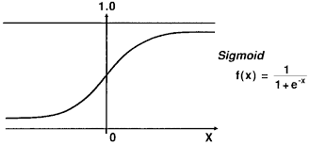
Logistic Regression
It is a classification based technique that works on discrete data rather than continuous.
The hypothesis function used here is called the sigmoid function given by:
Values greater than 0.5 have been classified as survived (1) and others to 0.
We get a score of 81.59% with 214 correct predictions.

Slide 9
K-Nearest Neighbours
K nearest neighbors is a classification algorithm highly useful in classifying an unknown dataset primarily on the similarity of the neighboring results.
The object is assigned its membership to a class by majority vote of its k nearest neighbors.
The degree of ‘closeness’ is calculated by distance of a said ‘object’ to its k neighbors.
The model is trained with the value of k equal to 3 which yielded 86.31% with 232 correct predictions

Slide 10
Decision Tree
In decision tree, the results are branched according to a particular condition and this branching continues with further conditions.
It is used as an application of supervised machine learning.
The algorithm itself evaluates particular decision’s importance which is called ‘feature classifier’.
On applying the model with same parameters we get an accuracy of 92.82 % with 250 correct predictions.

Slide 11
Random Forest
Random forest builds forest of random trees that are trained with bagging method.
It merges multiple decision trees to get modre accurate and stable predictions.
It selects best features among all features leading to beter randomness.
This Model yields accuracy of 92.82 % with 250 correct predictions.

Slide 12
Decision Tree Hypertuning
The decision tree algorithm has further been hypertuned where random state = 1, max depth = 7 and min_sample_split = 2. Ie Tree upto 7 levels and 2 children max.
It is easier to visualise a decision tree with only 7 levels.
This algorithm gave us an 87.00% accuracy.

Slide 13
Support Vector Machines
Support vector machines algorithm is like a knife used to separate data.
Each data item is plotted as a point in n-dimensional space with value of each feature being the value of a particular coordinate.
Classification is performed by finding a hype plane that discerns the two classes very well.
It has a unique feature to ignore the outliers, hence it is robust to it.
The algorithm yielded us an accuracy of 81.48 %.

Slide 14
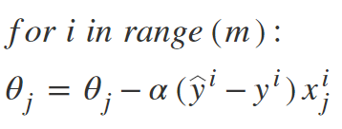
Stochastic Gradient Decent
The word ‘Stochastic’ means a system or a process that is linked with random probability.
In a typical Batch Gradient Descent, a batch of samples is taken at each iteration to find global minima. However this becomes computationally expensive when we have huge data.
This problem is solved by stochastic gradient descent where at each iteration a batch of size 1 is used for applying gradient decent.
Algorithm:-
The algorithm yielded us an accuracy of 79.12 %.

Slide 15
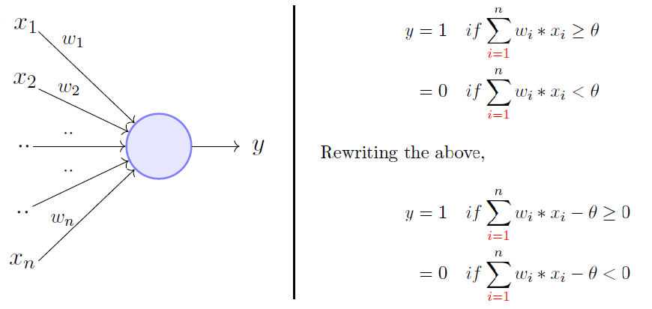
Perceptron
It is the simplest form of a neural network which consists of single neuron for computation.
There are no hidden layer. The Input and Output layers are same.
The Accuracy of perceptron model is 81.59 over test data.

Slide 16
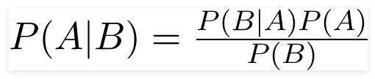
Naive Bayes
A Naive Bayes classifier is a probabilistic machine learning model that’s used for classification related problems.
This algorithm is based on Bayes Theorem.
Assumptions:- 1. Each feature makes an independent contribution. 2. Each feature makes an equal contribution.
Bayes Theorem
The algorithm yielded us an accuracy of 78.00 %.

Slide 17
Proposed Algorithm- Stacking
We have tried to implement Stacking- one of the ensembler methods.
Ensembling makes use of two or models in hope of getting better results.
Stacking is one of the ensmebler models where primary objective is to increase mean accuracy as well as to reduce high variance.
Stacking incorporates characterstics of both bagging and boosting.
Stacking consists of two or more classifiers which act as level-one classifiers.The results from these classfiers act as input for a meta-classifier. This meta-classfier gives final prediction

Slide 18
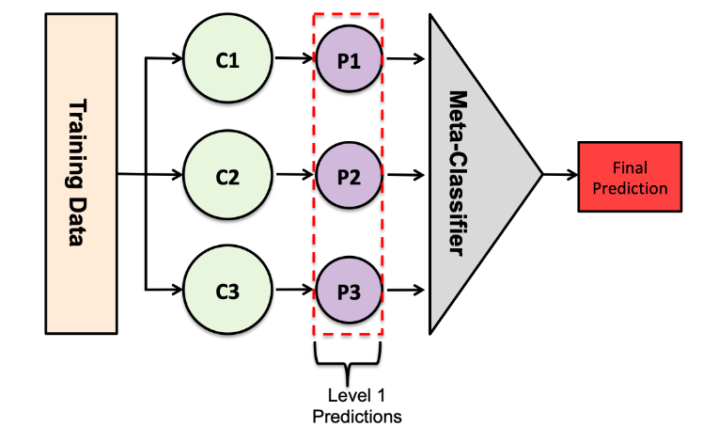
Proposed Algorithm- Stacking(Cont.)
Our Stacking model has 5 level-one classifiers- Random forest, Decision Tree, Extreme Gradient Boosting, Gradient Boosting Machine and Bagging. Meta-Classifer used is logistic Regression.

Slide 19
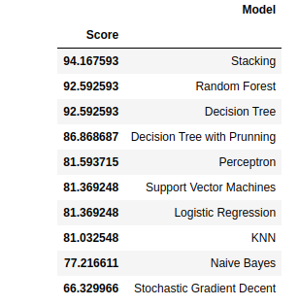
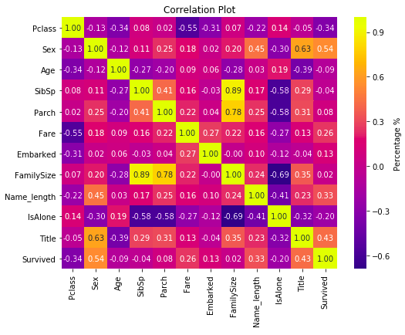
Observation

Slide 20
Observation(Cont.)
We see that from all of the existing algorithms , Decision Tree and random Forest give best best performance i.e. 92.59 percent.
Naive bayes give poor performance, reason being due to the assumption of Naive Bayes that all features contribute equally and are independent to each other which is not in our case as seen in correlation table.
Stochastic Gradient Decent inspite of one of the good algorithms, fails here dude to underfitting and its more linear nature.

Slide 21
Observation(Cont.)
The hyperparameter tuned Decision Tree gives accuracy less than to that of untuned Decision Tree. Tuned model is overfitted over training data. Moreover this model is more complex as well takes more time in training as well as in making predictions.
Our Stacked model performs extremely well over test data with a accuracy over 94.1675 percent. This best mean accuracy acheievable so far.

Slide 22
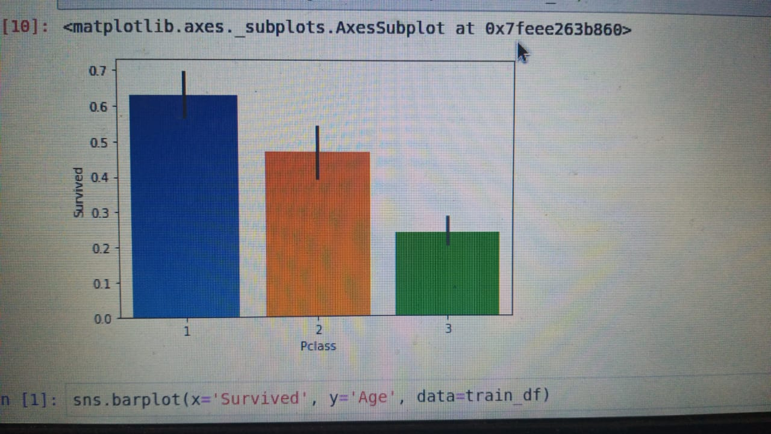
Results
Our proposed Stacked modesl give highest accuracy of 94.1675 percent. This is greater than all of the exisiting algorithms we have discussed.
The analysis showed that the attributes Age, Class of compartment and Gender are the important features to the model building.
Further analysis shows that the majority of passengers who survived occupied the first class.
.

Slide 23
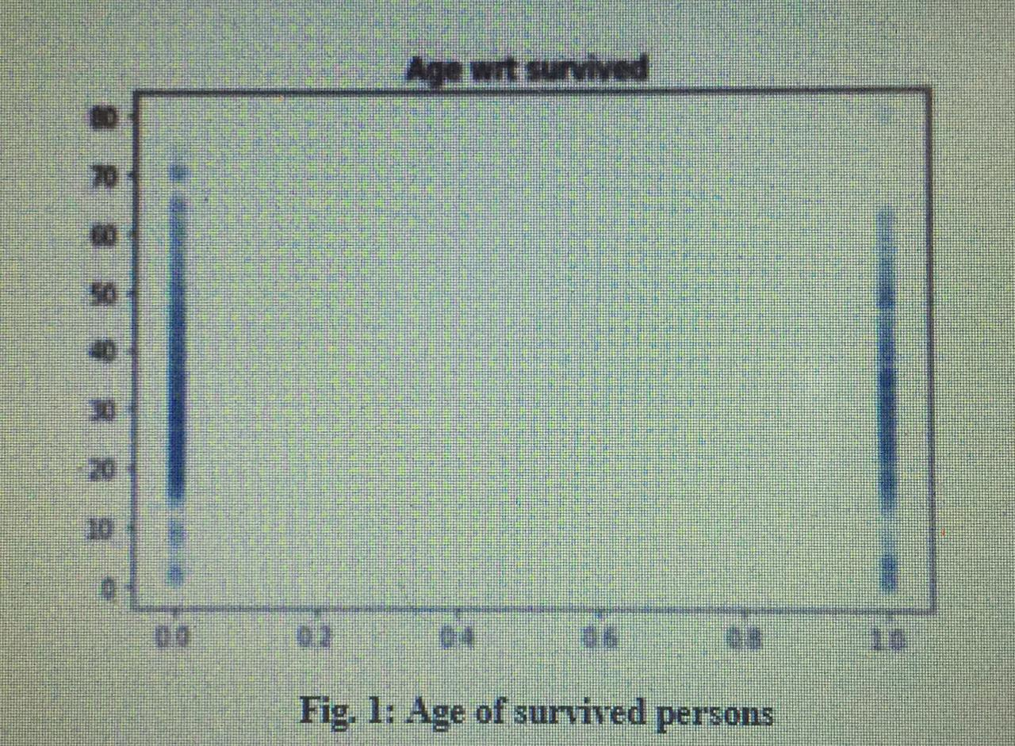
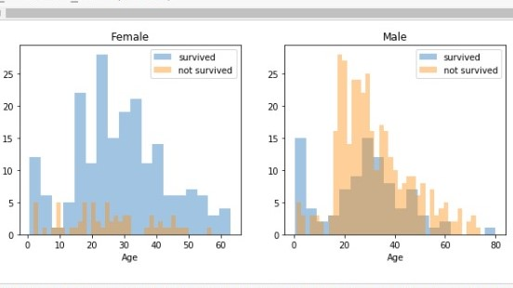
The majority passengers surviving were of age group between 20-30.
The passengers surviving were majorly female. The gender is found to me the most important feature for classification.

Slide 24
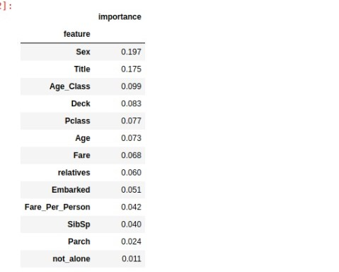
The importance of features was analysed to be in order:

Slide 25
Applications
We can use the model both for predictive and classification purposes.
We can predict the missing values of attributes and even the events that may happen in future.
The predictive model can be used to predict chances of survival and can be used to prevent any mishap in future.
The decision tree gave the best accuracy, hence we know which model works the best for such data.

Slide 26
Conclusion
The comprehensive research gives us a result with decision tree and random forest having the highest score with 92.82% correct predictions and lowest false discovery rate.
We our proposed model which is based on stacking shows accuracy about 94.1675 percent.
The research also made us aware of the features that are highly relevant to the prediction of survival of a passenger, with Sex being a feature with highest importance
The correlation between factors first evaluated using a basic formula was also justified in some cases and defied in the others.

Slide 27
Future Scope
Future work may include using other algorithms like K means, gradient boosting, adaboost, further hyper tuning the decision tree algorithm and even using advanced neural networks as well as Reinforcement learning.
Validating other techniques like assigning feature importance, introducing a new feature altogether that is, a more robust preprocessing could improve the accuracies and may yield different results for different algorithms

Slide 28
Contribution
Abhinav – Preprocessing and manipulation of data and Analysis of models.
Aakarsh - Building and Training models and Analysis of models.
Abhishek Dixit - Training and Analysis of models.
Manoj Kumar Mahour - Collection of Datasets and Analysis of models.

Slide 29
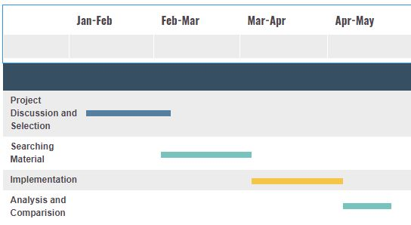
Gantt Chart

Slide 30
References
[1] Kaggle.com, ‘Titanic:Machine Learning form Disaster’,[Online]. Available: http://www.kaggle.com/. [Accessed: 29-October-2019].
[2] Zhao, Zheng, and Huan Liu. "Spectral feature selection for supervised and unsupervised learning." Proceedings of the 24th international conference on Machine learning. ACM, 2007.
[3] Disaster, CS229 Titanic–Machine Learning From. "Eric Lam Stanford University."

Slide 31
THANK YOU!!

